Slide 1

FARMER HELP-LINE PORTAL
S.NAME : S.NAGI REDDY
R.NO :20BCE10999
SUBJECT :FRONT-END DEVELOPMENT
TOPIC :FARMER HELP-LINE PORTAL
Faculty :Anurag Tiwari sir

Slide 2
ABOUT WEB-PAGE
This Farmer Portal facilitates a single window solution to the farmers and stakeholders to disseminate the information about the Government schemes , market rates, Seed information, Farm Machinery, Fertilizers, soil information, weather information, advices ,problems and solutions in farming sector.
It also provides easy portal access by providing various required links for government schemes , weather information, market rates , problems along with solutions and other relevant links.
It helps farmers to get all the required information at one place without any delay and waste of time.
There is also entry form for writing query. So that people get their query resolved from experts after submitting their query.
Their is a buyer and seller page where farmer can enter the crop and required details so that the buyer can see the information and contact them and buy the crop that he want, so that both buyer and seller will be beneficial without mediator.

Slide 3
BUYER AND SELLER PAGE BACKEND
SELLER FORM BUYER FORM
S.NAGI REDDY R.RAMESH
+9196******14 +9191******12
WHEAT PADDY
500KG’S 1000KG
MADHIRA, KHAMMAM,TELANGANA, 507203 HYDERABAD,TELANGANA, 417003
MINIMUM SELLING PRICE(MSP) 1KG=30RS MINIMUM BUYING PRICE(MBP) 1KG=35RS

Slide 4

SCREENSHOTS

Slide 5
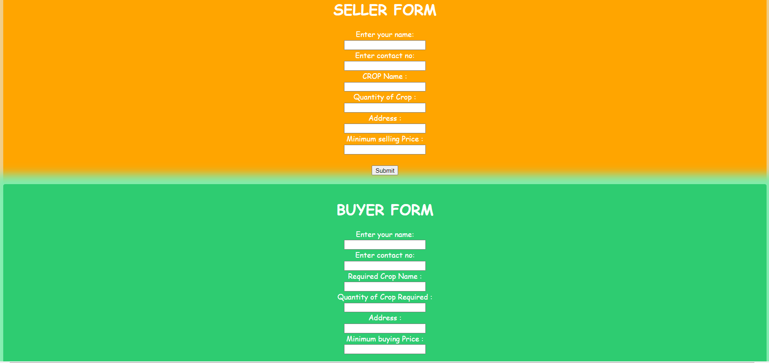

Slide 6
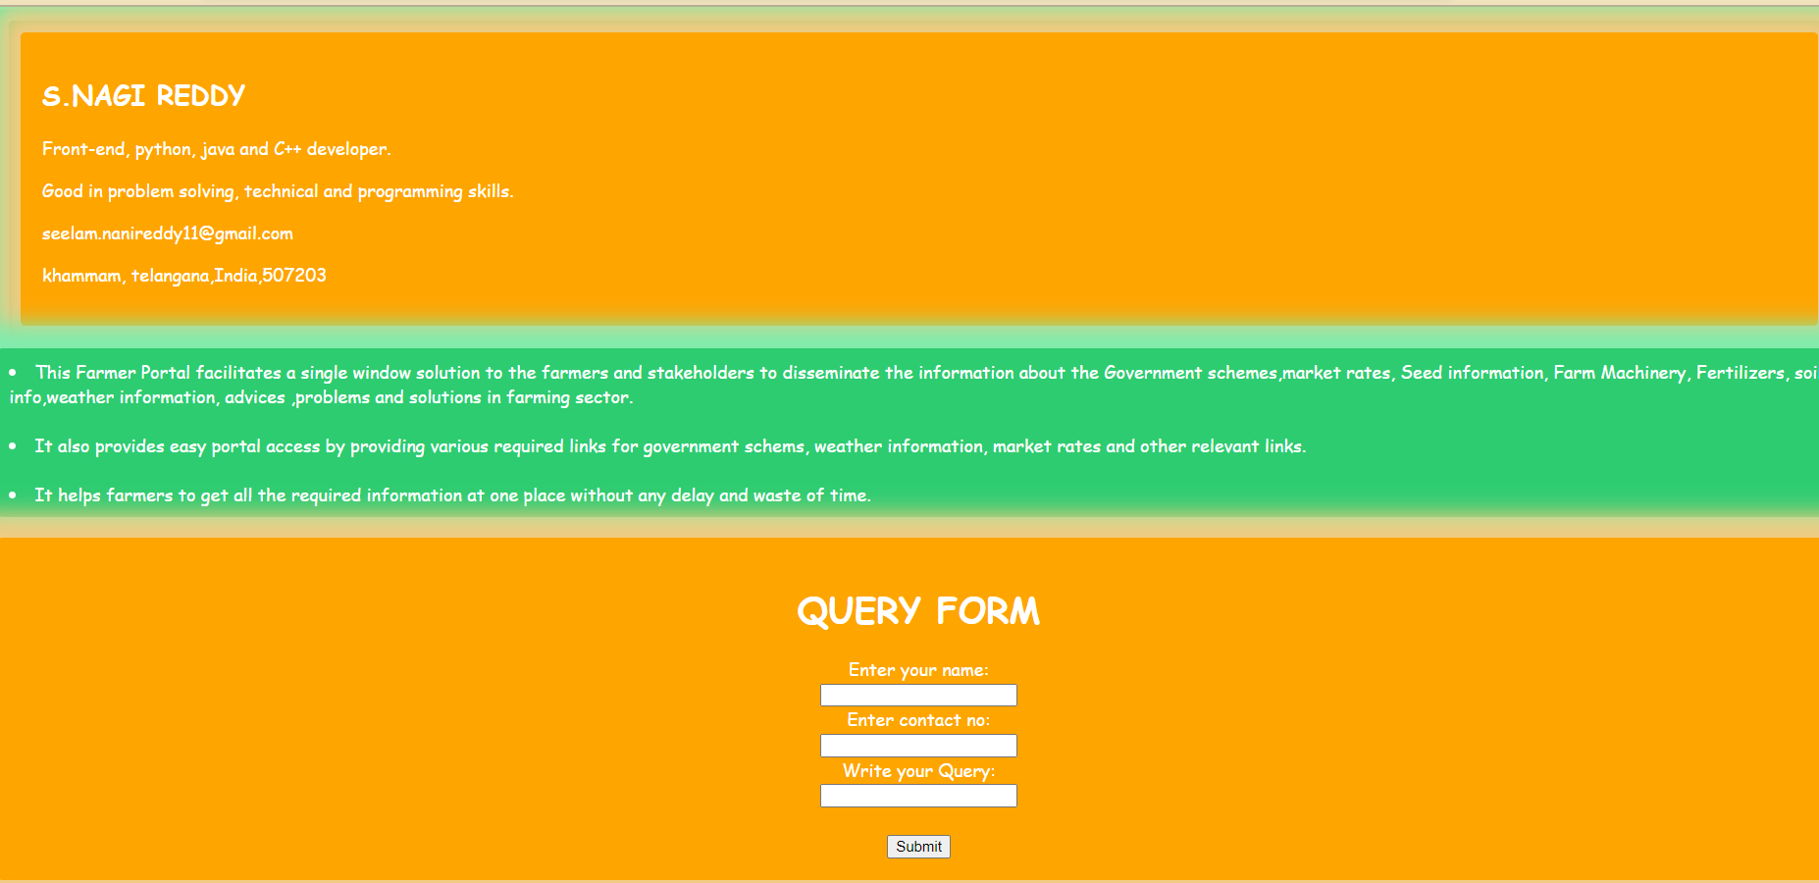

Slide 7
FUTURE SCOPES
Implementation database to the buyer and seller form.
Adding chat bot .
Adding backend to search button.
Adding new features.

Slide 8
Thank you

